Slide 1
Mathematical Models of Systems
Chapter 2
Second Lesson

Slide 2
Review
Basic concepts about control systems
Key mechanisms for control
History of the development of control theory
Basic information about this course
Basics about LTI systems
Linearization of a nonlinear system
Linear system modeling
Laplace transformation
Transfer function of a linear system

Slide 3
Outlines
Block diagram of a linear system
Block diagram transformation
Signal-flow graph
Gain formula (Mason Formula)
State space model
State equation versus transfer function – from SE to TF

Slide 4
Block Diagrams
第<number>页
Complex control systems can be represented by block diagrams
Block diagrams consist of unidirectional, operational blocks that represent the transfer function of the components or subsystems
2
input
Output
1
3
4
Output
input
G1
G2
G3
G4

Slide 5
Transfer function of dc motor system
第<number>页
i
＋
u
ω
m
r
m
L
－
u
k
u
e
k
e
d
2
1
－
＋
u
b
Speed
Measurement
Motor
Controller
DC motor
Load
Input:
u
Output:
r
ω

Slide 6

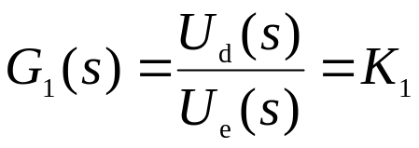
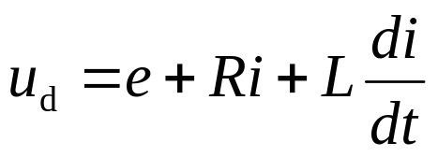
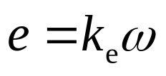

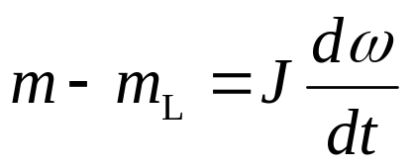
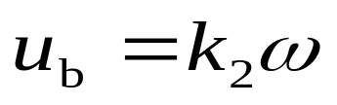
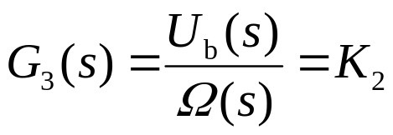
Transfer function of dc motor system
第<number>页
Controller:
DC motor :
Load :
Speed
measurement
motor :
Notes:
Angular velocity
Rotational inertia

Slide 7
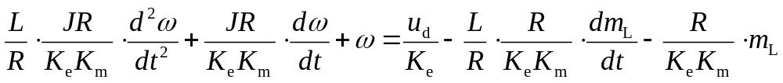
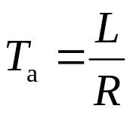
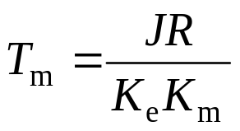
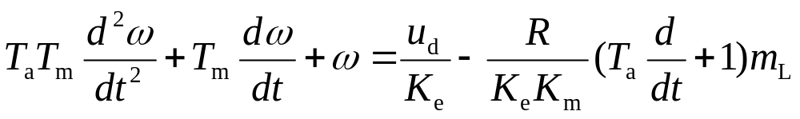
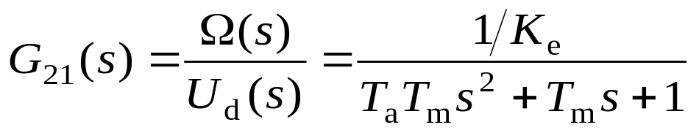
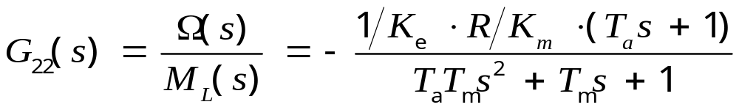
第<number>页
Dynamic equation of motor-load
Set:
Transfer function of the system:
When no load:
Transfer function of the system:
When u_{d} = 0:

Slide 8



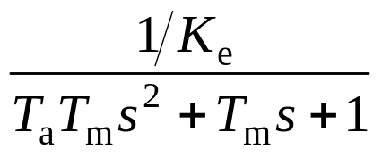




How to construct block diagram of a system?
第<number>页
  Construct blocks of subsystems
  Connect blocks according to the signal flow
No load
＋
－

Slide 9

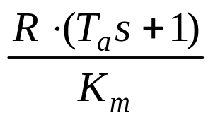
Transfer function of dc motor system
第<number>页
Have load:
－
＋
－
＋

Slide 10
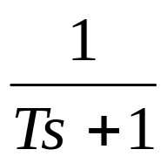
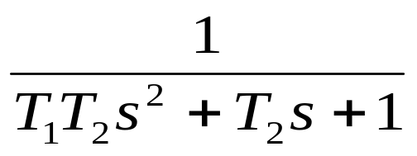

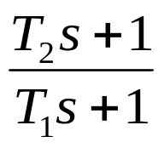

Transfer function of common blocks
第<number>页
Proportional block
Inertial block（1st order）
Oscillation block（2nd order）
Integration block
Lead-lag block
Time delay block
k

Slide 11






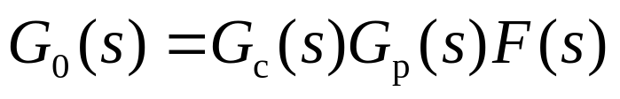
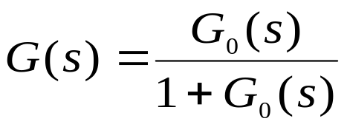
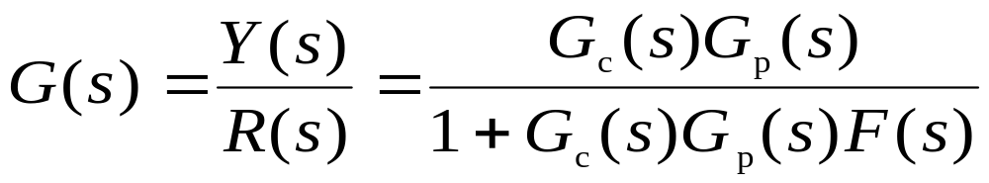
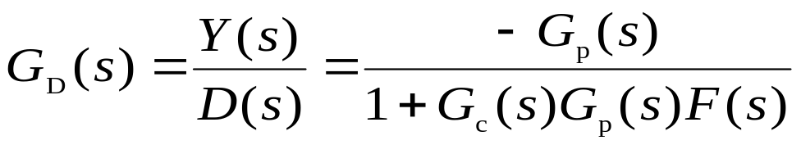
Block Diagram Representation of Feedback Systems
Disturbance
Controller
-
Process
+
+
Input (ref)
Output
-
Feedforward channel
Sensor
Feedback channel
Unit feedback
Open-loop TF:
Closed-loop TF:
TF from D to Y:

Slide 12
Outlines
Block diagram of a linear system
Block diagram transformation
Signal-flow graph
Gain formula (Mason Formula)
State space model
State equation versus transfer function – from SE to TF

Slide 13
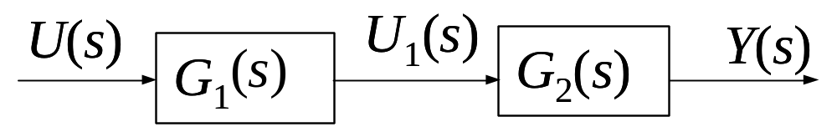
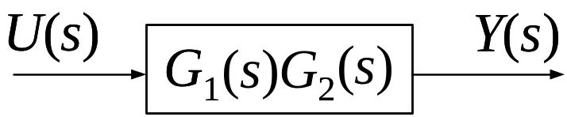
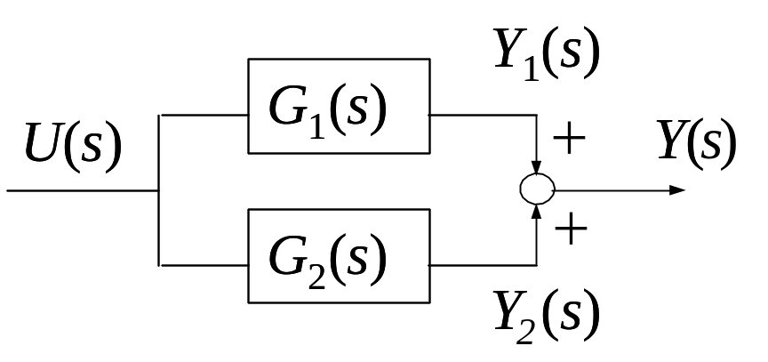
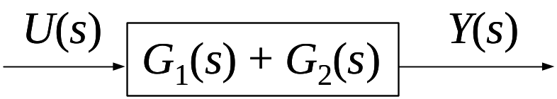
Block Diagram Transformation
第<number>页
The principle for block diagram transformation is to keep the input-output relationship of the representations constant before and after reduction.
series connected
parallel connected
Notes:
The block diagram representation of a given system often can be reduced by block diagram reduction techniques to a simplified block diagram with fewer blocks than the original diagram.

Slide 14
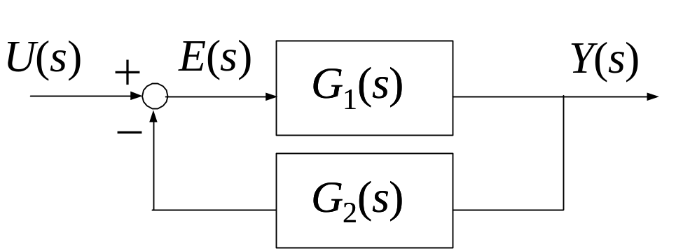
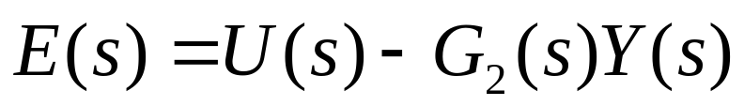
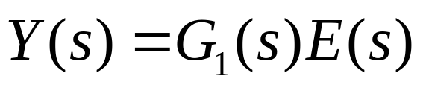
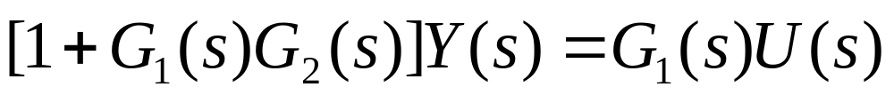
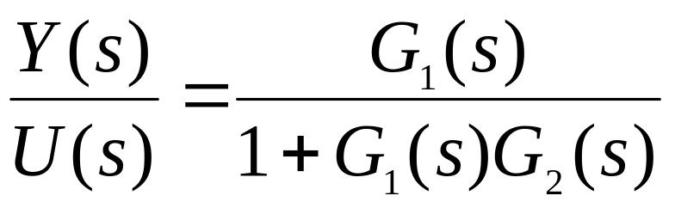
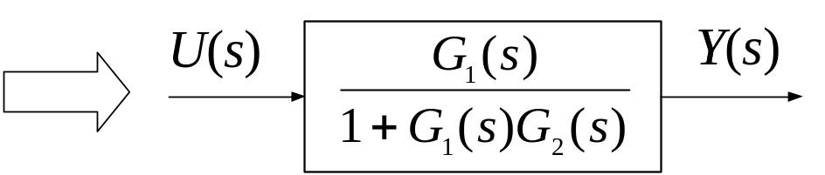
第<number>页
Negative feedback:
Notes:
The block diagram representation of a given system often can be reduced by block diagram reduction techniques to a simplified block diagram with fewer blocks than the original diagram.

Slide 15






第<number>页
Moving a summing point
+
+
+
+

Slide 16

第<number>页
Moving a pickoff point

Slide 17
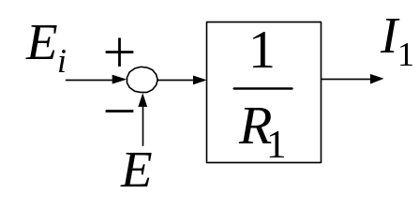
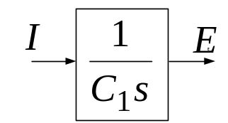
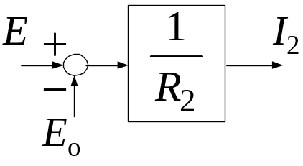
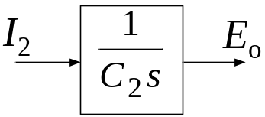
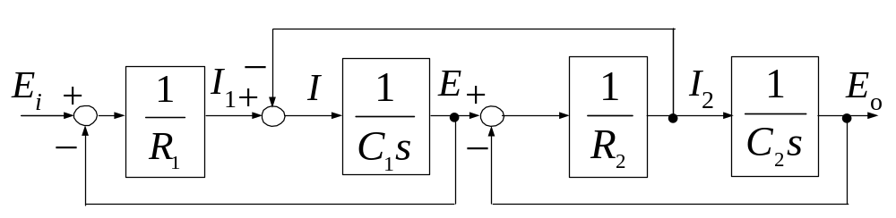
第<number>页
Q: Please find out the
transfer function
of the circuit on the right
i₁
R₁
i₂
R₂
i
e_{i}
e
C₁
C₂
e_{o}

Slide 18
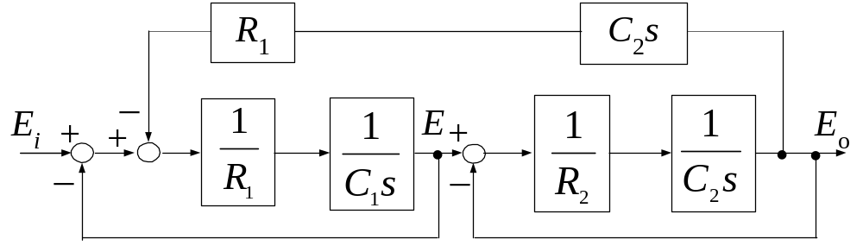
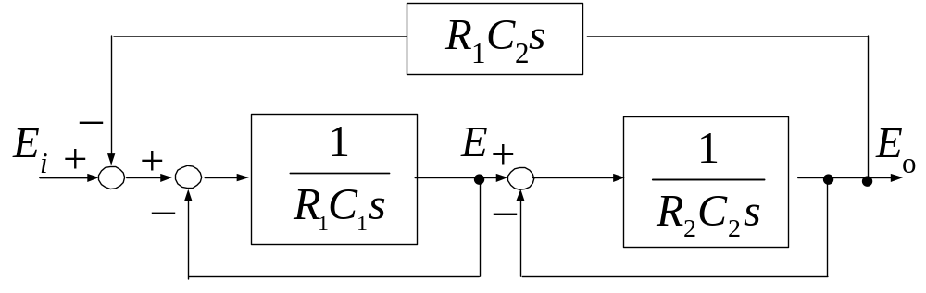
第<number>页
Notes:
Commutative law
Associative law

Slide 19
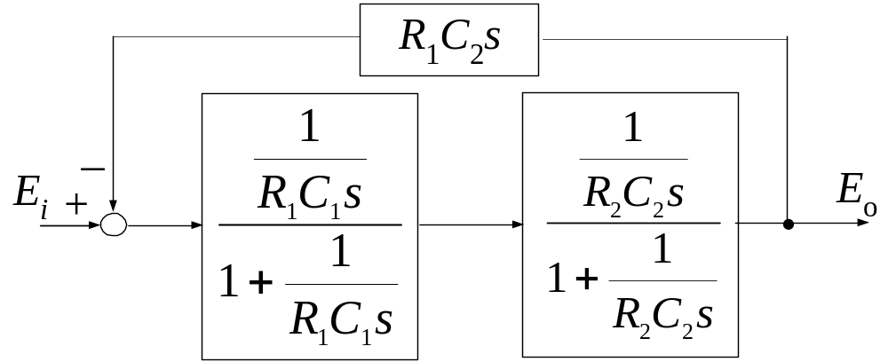
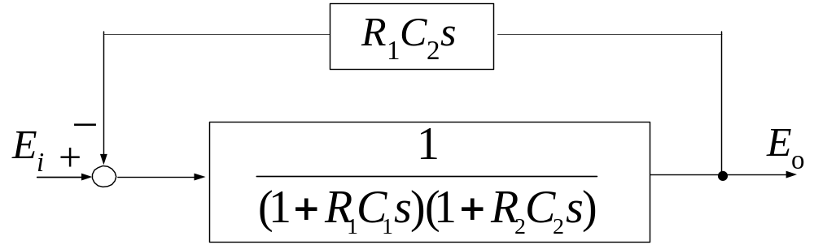
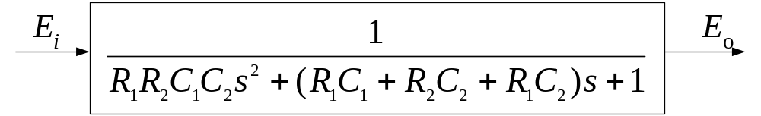
第<number>页

Slide 20
Outlines
Block diagram of a linear system
Block diagram transformation
Signal-flow graph
Gain formula (Mason Formula)
State space model
State equation versus transfer function – from SE to TF

Slide 21
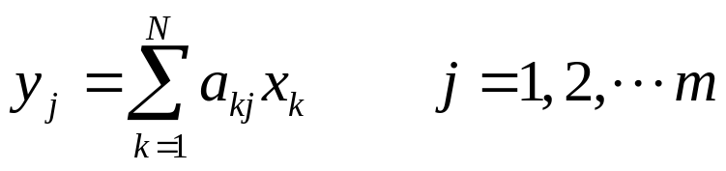
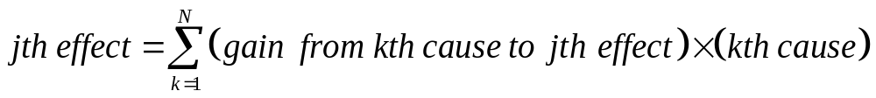
Signal-Flow Graphs
Introduced for the cause-effect representation of linear systems that are modeled by algebraic equations
In the case when the system is represented by a set of integro-differential equations, Laplace transform must be performed first to convert the integrodifferential equation into an algebraic equation.
May be regarded as a simplified version of a block diagram constrained by more rigid mathematical rules.

Slide 22


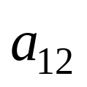
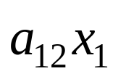
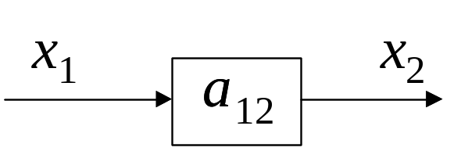
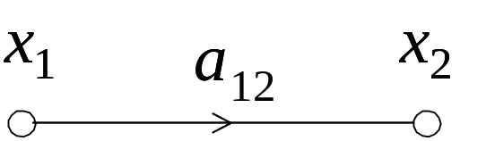
Signal-Flow Graphs
Nodes represent variables. Normally, the nodes are arranged from left to right, from the input to the output, following a succession of cause-and-effect relations through the system.
Branches with direction and gains represent cause-and-effect relationship
Signals travel along branches only in the direction described by the arrows of the branches
A signal traveling along a branch between and is multiplied by the gain of the branch, , so that a signal is delivered at .

Slide 23
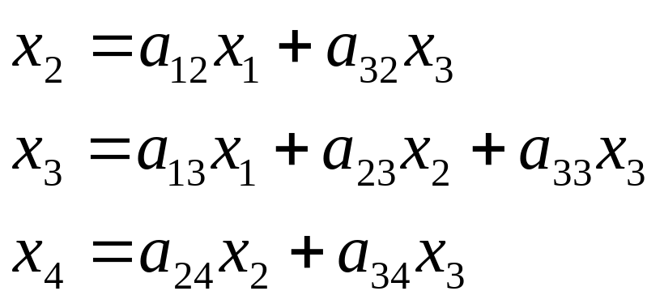

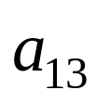
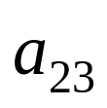





Example
input:
output:

Slide 24


Tips
Summing points don’t exist anymore. A node is added to represent the variable after a summing point.
A node need be added to represent the variable at a pickoff point.
Special nodes are used to represent input and output variables.

Slide 25



Example
Q: Please draw the SFG of the circuit on the right. The input is u and the output is u_{c.}
A:

Slide 26



Slide 27
Outlines
Block diagram of a linear system
Block diagram transformation
Signal-flow graph
Gain formula (Mason Formula)
State space model
State equation versus transfer function – from SE to TF

Slide 28
Gain Formula (Mason Formula)
A gain formula is used to determine the input-output relations of a SFG by inspection
Definition of SFG terms
Input
  node(s) that only has(have) outgoing branch(es).
Output
  node(s) that only has(have) incoming branch(es).

Slide 29
Gain Formula (Mason Formula)
Definition of SFG terms
  Path: a branch or a continuous sequence of branches traversed from one signal node to another signal node.
  Forward path: a path that starts at an input node and ends at an output node, and along which no node is traversed more than once.

Slide 30
Gain Formula (Mason Formula)
Definition of SFG terms
  Loop: a path that originates and terminates on the same node and along which no node is traversed more than once.

Slide 31
Gain Formula (Mason Formula)
Definition of SFG terms (continued)
  Path gain: the product of the branch gains encountered in traversing a path.
  Forward-path gain: the path gain of a forward path.
  Loop gain: the path gain of a loop.
  Nontouching loops: two loops that they don’t share a common node

Slide 32








Gain Formula (Mason Formula)
Gain between input and output
Gain of an individual loop
Gain product of two nontouching loops
Gain product of any three nontouching loops
Gain of the kth forward path between input and output
The left part of that is nontouching of the kth forward path

Slide 33











An Example
Q: Please find the gain of the following SFG.
A:
Loops:
Forward path:

Slide 34






Example 2.10
Q: Please find the gain
from U(s) to Y(s).
A: There are three loops and
each of them is nontouching
of other loops.
Loops:
Forward path:

Slide 35

Example 2.10

Slide 36



Example 2.11
Q: Please find the transfer function of
1
A: X(s) is a middle point. We can add an outgoing branch and make it an output
node. Then use Mason formula to get the transfer function.

Slide 37


Example 2.11 (Continued)
E(s) is not an input node. Mason formula can not be applied directly. Incoming
branches should be taken away before calculate the transfer function.

Slide 38
Discussions about SFG
Advantages
Disadvantages
Advantages
  Straight forward
  Easy to be implemented by computers
Disadvantages
  Complex

Slide 39
Outlines
Block diagram of a linear system
Block diagram transformation
Signal-flow graph
Gain formula (Mason Formula)
State space model
State equation versus transfer function – from SE to TF

Slide 40









State Space Models
Dynamic systems (LTI) are represented by ordinary differential equations (ODE) that can be high order ones;
First-order ODEs is simpler than high-order ones to solve;
High-order ODE can be decomposed into a set of first-order ODEs

Slide 41
Term Definition of State Space Models
State: the state of a system refers to the past, present and future of the system;
State Variables: a minimal set of variables such that knowledge of these variables at any time t₀ and information on the input excitation subsequently applied are sufficient to determine the state of the system at any time t > t₀;
State Equations: a minimal set of first-order ordinary differential equations that completely define the future behavior of a dynamic system;
Output Variable: a variable that can be measured;
Output Equation: an expression of output variable which is an algebraic combination of the state variables;

Slide 42






State Space Equation of SISO
are scalars

Slide 43



Example

Slide 44






Example
Question: find a state-space representation of the following system.
Solution: define state variables as

Slide 45

Example
Hence, the state equation is
What’s the output equation?

Slide 46









Block Diagrams of State Equations
+
+
Inertial
Non-inertial

Slide 47






State Space Equation of MIMO
vector
vector
vector

Slide 48
Remarks about State Space Models
All the state space models of systems have the same form, which is comprised of a state equation and an output equation, no matter the system is an open-loop control system or a closed-loop system, a subsystem or a whole system.
Although the state variables of a system are the minimal set of variables that completely determine the dynamic behavior of the system, the choosing of state variables is not unique. But the number of state variables is constant.
The number of state variables of a system depends on the number of independent dynamics of the system.

Slide 49
Question
If a system can be described by different state equations, what is the relationship between the state equations?

Slide 50











Similarity Transformation
SISO:
Transformation:
where
is a
nonsingular matrix
If set

Slide 51
Question
Both transfer functions and state equations describe the dynamics of systems, what’s the relationship between them?

Slide 52
Outlines
Block diagram of a linear system
Block diagram transformation
Signal-flow graph
Gain formula (Mason Formula)
State space model
State equation versus transfer function – from SE to TF

Slide 53




Relationship between TF and SE
From SE to TF
SISO:
Laplace Transform:
Set

Slide 54






Relationship between TF and SE
For MIMO:

Slide 55
Question
A system may have different state equations but one transfer function for a certain input-output pair, will different state equations lead to different transfer function for the same input-output pair?

Slide 56

投票
最多可选1项
Different state equations lead to different transfer function for the same input-output pair
A
True
B
False
提交

Slide 57




Invariability of TF
TF keeps invariant after similarity transform

Slide 58
Wrap-up
Block diagram of a linear system
Block diagram transformation
Signal-flow graph
Gain formula (Mason Formula)
State space model
State equation versus transfer function – from SE to TF

Slide 59
Assignment
第<number>页
Page 34
  1.
  2. (b)
  3. (c)

Slide 60
Assignment
Page 35
5: (b)
6: (c)
9

Slide 61

Discussion
第<number>页
Autonomous system
In mathematics, an autonomous system or autonomous differential equation is a sytem of ordinary differential equations which does not explicitly depend on the independant variable. When the variable is the time, they are also named Time-invariant system

Slide 62
Discussions
Can signal-flow graphs be applied to nonlinear systems?
Can the gain formula be directly applied between any two nodes of a SFG?
For an electric circuit with R, L and C, is the number of its state variables equal to the number of L and C?

Slide 63
Discussions
For a multi-input multi-output LTI system, if the inputs and outputs have been determined, are the denominators of all the elements in the system transfer function matrix the same?

Slide 64
Discussions
For a non-proper system, such as a pure derivative block, will it change to a proper one if we reverse its input and output?

Slide 65





Discussions
Transfer function from to :
Non-proper system

Slide 66

Discussions
Transfer function from to :
Proper system

